Slide 1
Web Accessibility for Washington Ports
What's new, what compliance actually looks like,
and the six things to do on Monday morning.
Washington Public Ports Association • May 19, 2026

Slide 2
One
How websites shut people out.
Common friction points for people navigating websites with assistive tech.

Slide 3
Improperly tagged navigation obscures menus.
“Home. Commission.
Tenants. Permits…”
Is this a menu?
The Fix: Real <nav> with <a href> links instead of <div onclick>. Now the
Reader announces "Navigation, 5 items" — plus keyboard navigation is enabled.

Slide 4
If you can't see where the keyboard is, you can't use the site.
Cursor is somewhere in there.
Press ‘Enter’ and hope!
Two lines of CSS. Suddenly the
keyboard works for everyone.

Slide 5
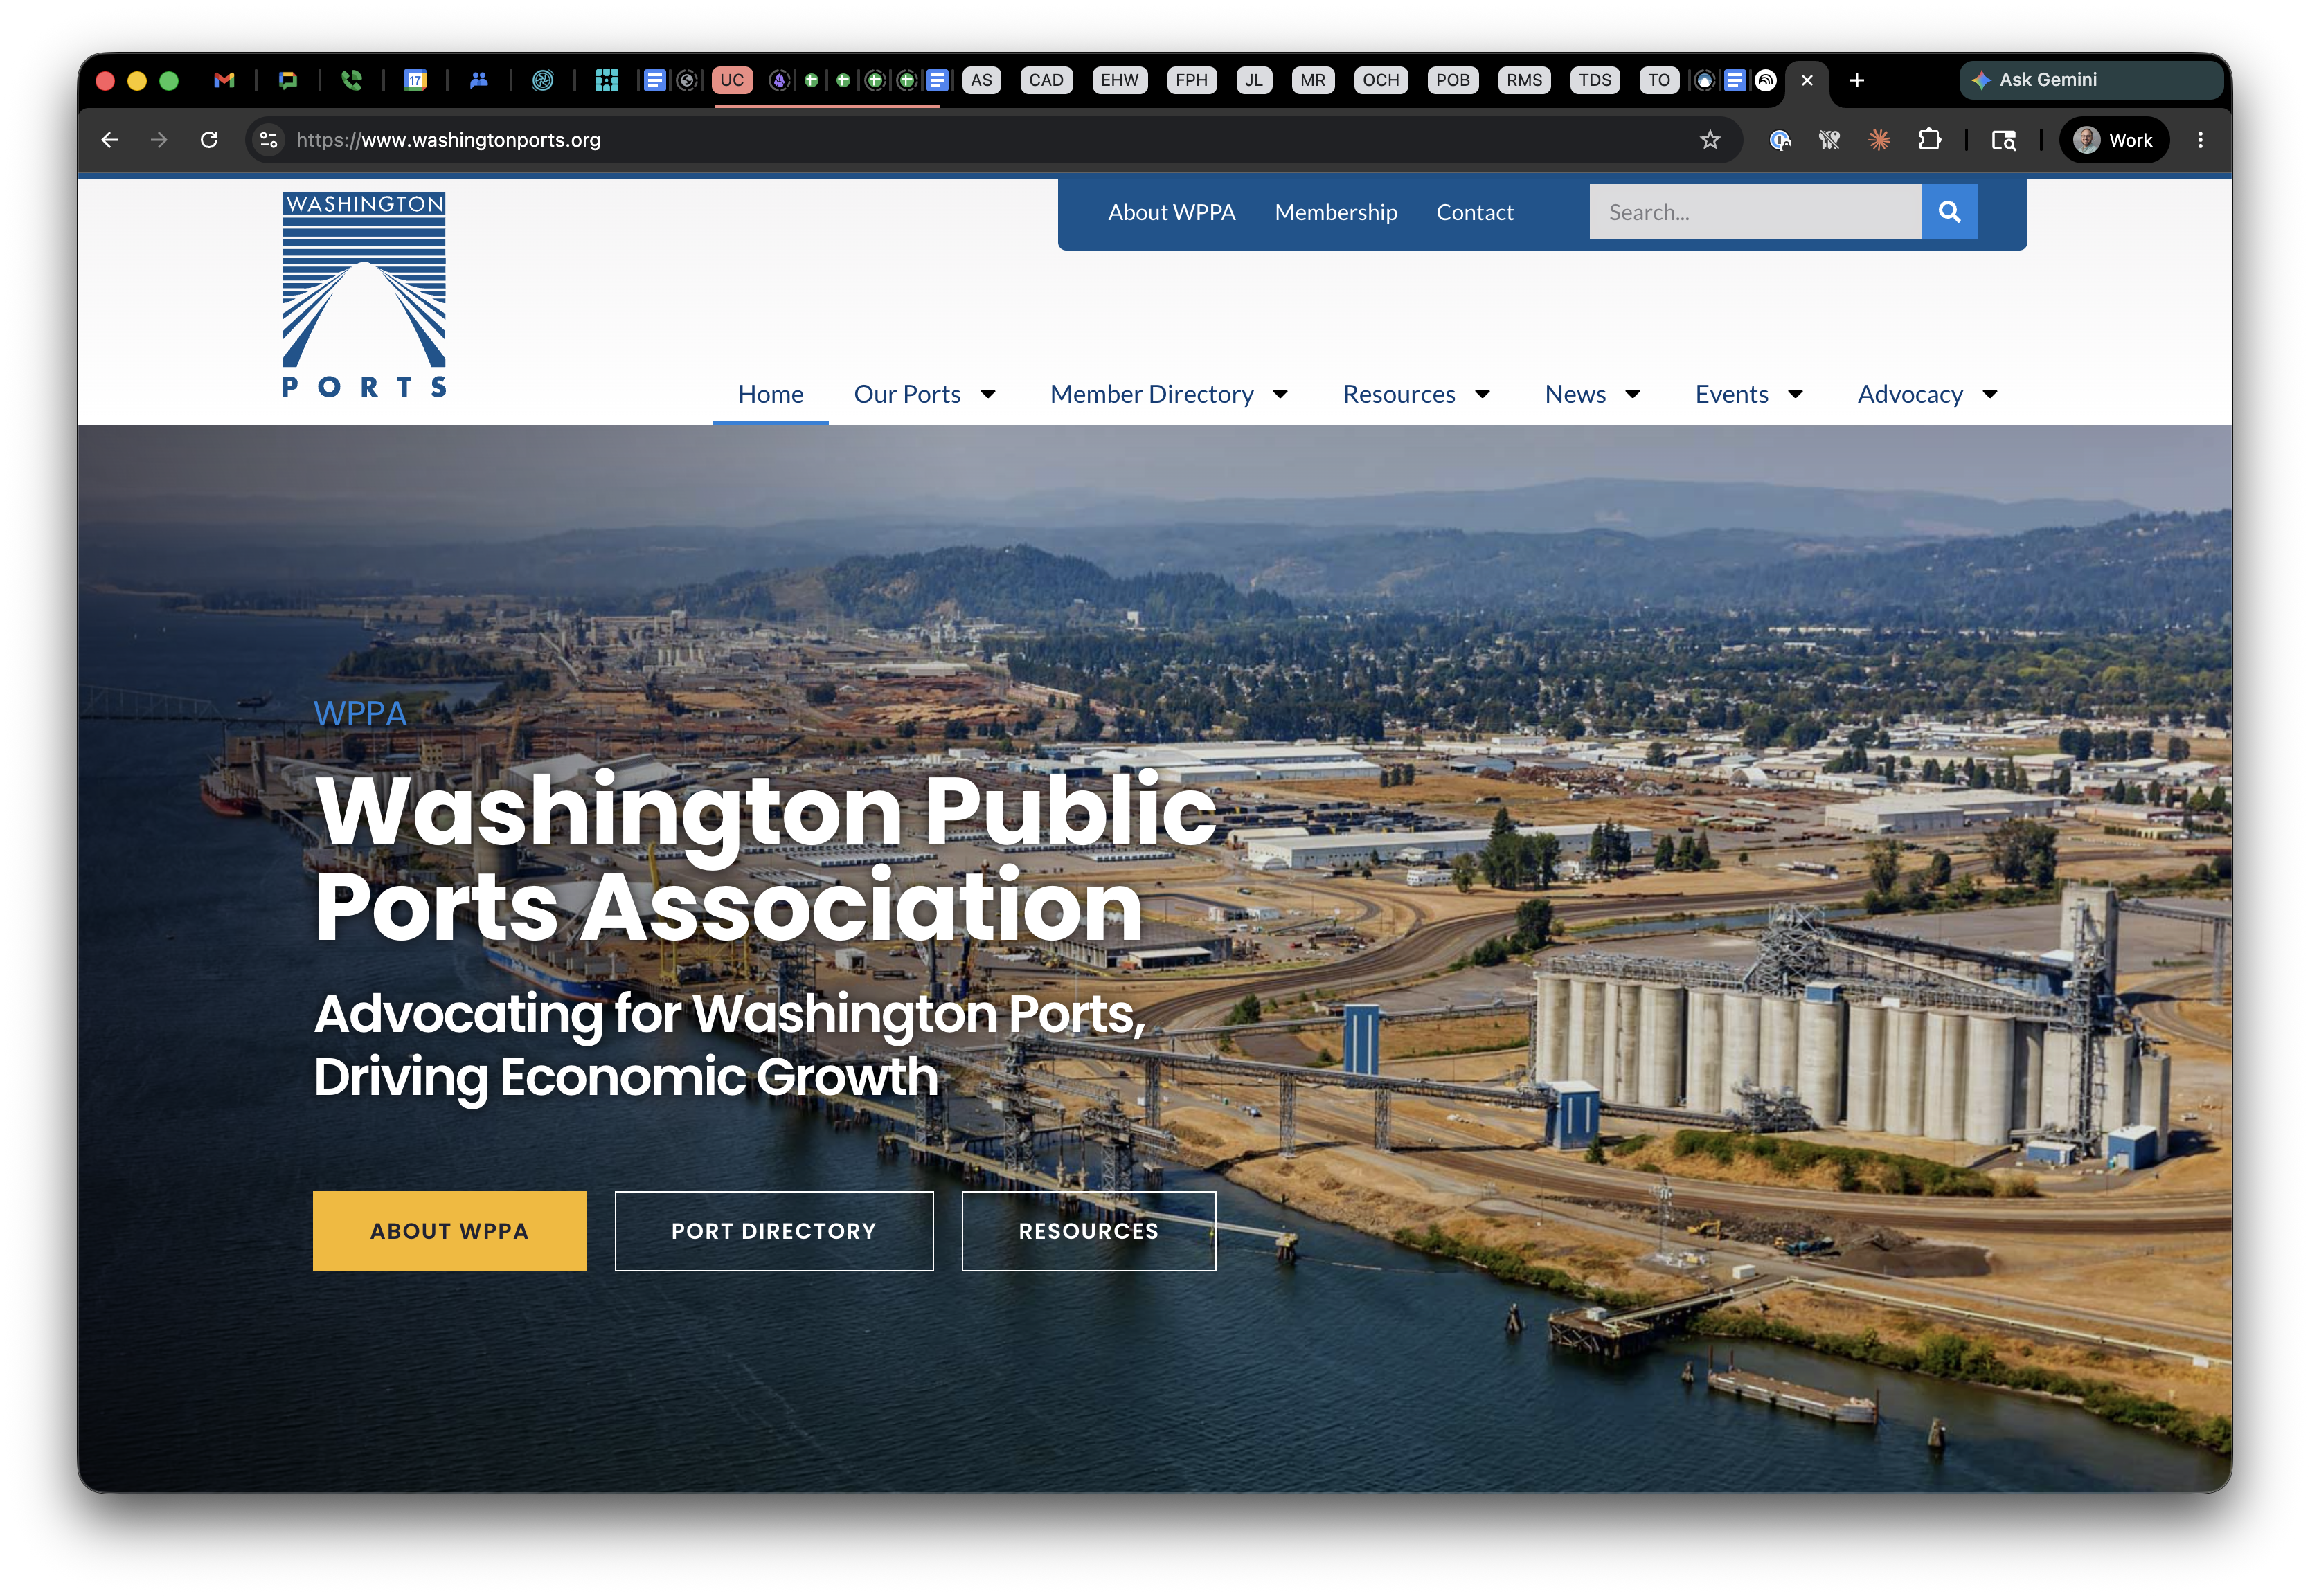
Fields with no label are blank.

Slide 6
Unclear filenames and missing alt tags make documents confusing.
“‘Commisson’ underscore agenda underscore FINAL underscore v two
left-paren one right-paren dot p-d-f.”
The Fix: Change filename and title metadata: "Commission Agenda — May 2026.”
The reader announces the Title. Filename is what a human sees in their Downloads folder.

Slide 7
Two
What does it mean to comply?
DOJ's April 2024 rule made WCAG 2.1 AA the federal floor for state and local government websites — and for the digital services they pay vendors to run.

Slide 8
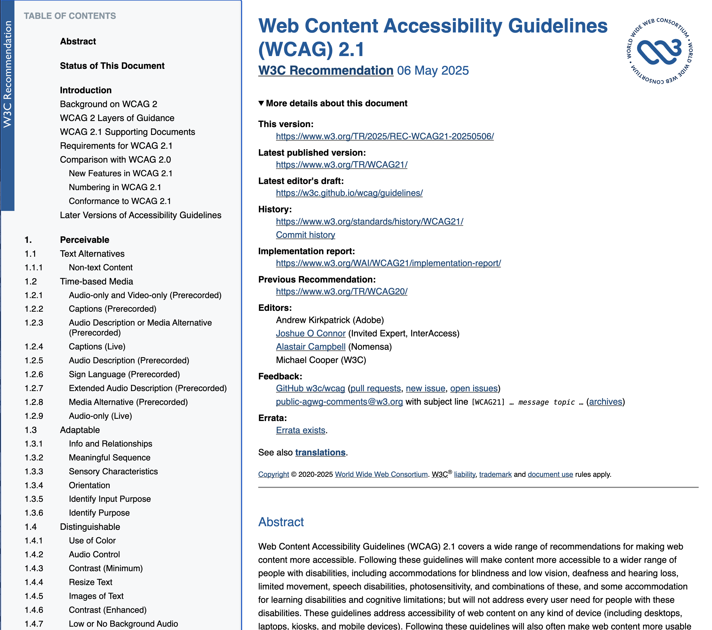
ADA Title II is the federal authority.
WCAG 2.1 AA is the technical floor.
ADA Title II
State and local governments — including special purpose districts. Nondiscrimination across all programs and services, online or off.
(28 CFR Part 35, Subpart H) Per RCW 36.96.010 + RCW 53.04.010, WA port districts are special purpose districts under state law. Confirm specifics with legal counsel.
WCAG 2.1 AA
Developed by the World Wide Web Consortium (W3C), DOJ adopted this standard in the April 2024 final rule. Meet it across your sites, apps, vendor systems, and documents to satisfy Title II requirements.
(w3.org/TR/WCAG21)
Section 504, Rehabilitation Act
Any entity receiving federal funds (FAA AIP, EDA grants — most ports qualify). Equal opportunity in federally-funded programs.
Section 508, Rehabilitation Act
Federal agencies only. Not directly applicable to ports.

Slide 9
WCAG 2.1 AA Compliance Timeline
ENTITY TYPE | DEADLINE
Governments serving 50,000+ | April 26, 2027
Governments serving fewer than 50,000 | April 26, 2028
Special district governments Port districts, that’s you. | April 26, 2028
Source: 28 CFR Part 35, Subpart H — the DOJ's 2024 web & mobile accessibility rule under Title II of the ADA. Confirm specific dates with your legal counsel.

Slide 10
The non-compliance penalties are real.
DOJ enforcement.
DOJ can bring civil suits under Title II — first violation up to $75,000, subsequent violations up to $150,000. Historically, enforcement against state and local government has been selective.
Private lawsuits.
This is the bigger real-world risk. Any individual with a disability can sue under Title II. The remedies are (1) injunctive relief — a court order to fix the site — and (2) the plaintiff's attorney's fees.
Section 504.
If you take federal funds — which most ports do — Section 504 carries a theoretical penalty of loss of those funds. Rare in practice, but it's on the books.

Slide 11
Three
What does compliance look like?
WCAG standards are organized around four principles.
Remember the acronym POUR. Everything else is detail.

Slide 12
POUR: The Four Principles of
WCAG 2.1 AA Compliance
Perceivable
Operable
People can sense the content — sight, sound, or assistive tech.
Every interaction works without a mouse, on any timing.
Understandable
Robust
Content and behavior are predictable. Errors are recoverable.
Built so assistive tech — present and future — can parse it.

Slide 13
Perceivable
“Required fields marked with red asterisk.”
Add a visible 'required' label and aria-required="true". Now every person — and every screen reader — knows.

Slide 14
Perceivable
Three things to verify on every page.
<img alt=“illustration
of eye”>
Alt text
Every meaningful image has a short, useful description. Decorative images get alt=“".
Contrast
Measured ratio between text color and background. Use a contrast checker, not your eye.
Text resize
Page must still work when text is doubled — no clipped buttons,
no overlapping elements.

Slide 15
Operable
Timeouts punish the people who need the most time.
“Session has expired. Form has been cleared.

Slide 16
Operable
Three things to verify on every page.
Tab Order
Keyboard moves through page in order content actually reads.
Focus indicator
A visible indicator on whatever element the keyboard is currently on.
Skip to content
First focusable link on the page. Lets a keyboard user bypass the nav.

Slide 17
Understandable
An error message should tell you what's wrong and what to do.

Slide 18
Understandable
Three things to verify on every page.
Page language
A single attribute on the root tag
tells the Reader which voice
and pronunciation to use.
Clear field labels
Every input has a real <label>
with explicit format.
Placeholders are not labels.
Consistent nav
Menus are in the same place, in the same order, on every page. Predictable structure is half of “understandable.”

Slide 19
Robust
Use the right element for the job.
The browser will do the rest.
A real button is focusable, clickable, keyboard-activatable, and announced by Readers.
A styled div is none of those.
One <h1> per page following nested structure. Readers build an outline users can jump through.
Properly encoded standard elements are recognized by every assistive technology.

Slide 20
Four
Real talk for Ports.
Three key problems likely affecting your website.

Slide 21
Vendor accessibility is your problem.
You can outsource the software, but not the liability.
Your permit portal. Your payment processor — Heartland, Stripe, PayPal. Your CivicPlus, Granicus, BoardDocs board-meeting agenda system. Your job-application form on NEOGOV, ApplicantPro, Indeed. All "off the shelf," all on your domain in the user's mind.
DOJ doesn't care who built it. If it's the service you provide to the public, you're on the hook for whether it's accessible.

Slide 22
A scanned PDF is often the equivalent of a photocopy of a document.
Meeting minutes, RFPs, lease agreements — published as scanned images.
The text is decorative pixels, not characters. The Reader has nothing to read aloud.
Fix: OCR + tagged PDF, or — better — publish as HTML in the first place.

Slide 23
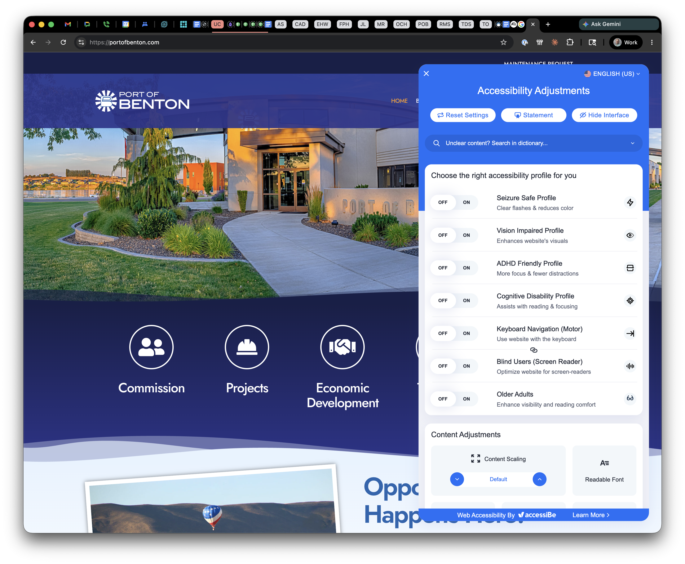
Accessibility overlays promise everything, fix very little.
DOJ has explicitly said overlays do not meet the rule.
JavaScript widgets that promises one-click ADA compliance do not fix your markup, labels, or focus order.

Slide 24
There are exceptions, but they are narrow.
1. Archived web content — clearly labeled.
Think old pages with meeting minutes, retired comprehensive plans, past annual reports.
2. Pre-existing electronic documents.
PDFs, Word, PowerPoint, Excel posted before your deadline. Doesn't apply to docs currently used to access services (applications, current ordinances).
3. Third-party content.
Public message board comments. Posts on a public gallery or social media.
Vendor content does not qualify for an exception.
4. Individualized password-protected documents.
Account-specific — think fee receipts, permit confirmations.
5. Pre-existing social media posts.
Old posts grandfather. New posts must be accessible.
Even when an exception applies — if a person with a disability requests access, you still owe an accessible version.

Slide 25
FIVE
Your homework for next week thru April 2028.
Six steps, phased across the next 23 months. Three to start now,
two by mid-summer, one that runs the whole way through.

Slide 26
Six things to get started on right away.
1.
Identify your ADA coordinator
One named person on the org chart. Not “everyone.”
2.
Inventory your digital footprint
Website, vendor apps, PDFs. Anything a citizen can reach.
3.
Run a free accessibility scan
Automated scans catch ~30%.
Enough to know where the cliff is.
4.
Audit vendor contracts
Look for an accessibility clause and VPAT (Voluntary Product Accessibility Template) — or flag it.
5.
Set a "from now on" policy
Nothing new ships without accessibility review. Stops the backlog growing.
6.
Plan & execute remediation work
Prioritize by user impact. Fix in waves. Retest. Starts once 1–3 are done.

Slide 27
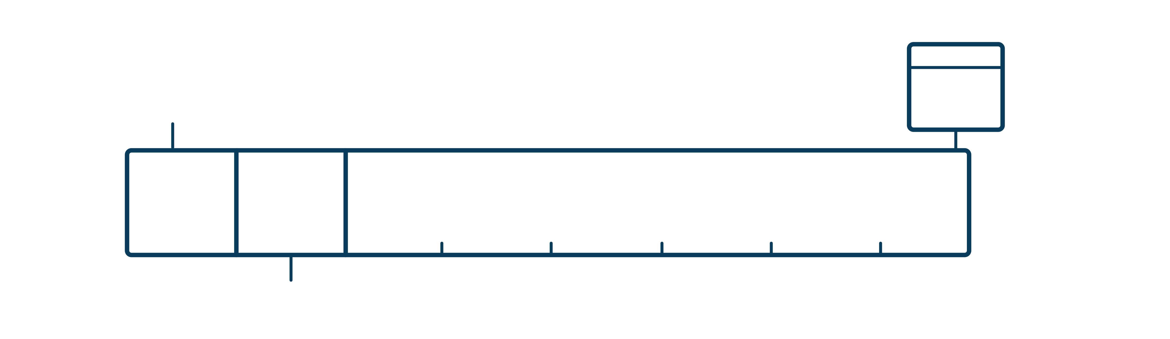
You have time.
But there’s a lot of work to be done.
Foundation
First 3 months (May–Aug 2026)
1. Identify coordinator · 2. Inventory current footprint · 3. Free accessibility scan
Apr 26
2028
Execution
17 months (Nov 2026 → Apr 2028) 6. Plan & execute remediation
Setup
Months 3-6 (Aug–Nov 2026)
4. Vendor audits · 5. "From now on" policy

Slide 28
Accessibility is just good web design.
Port districts exist to build infrastructure that connects people. Pick your coordinator this week. Inventory your footprint next.
There's a lot of work to do — but nearly two years to do it.
Washington Public Ports Association • May 19, 2026

Slide 29
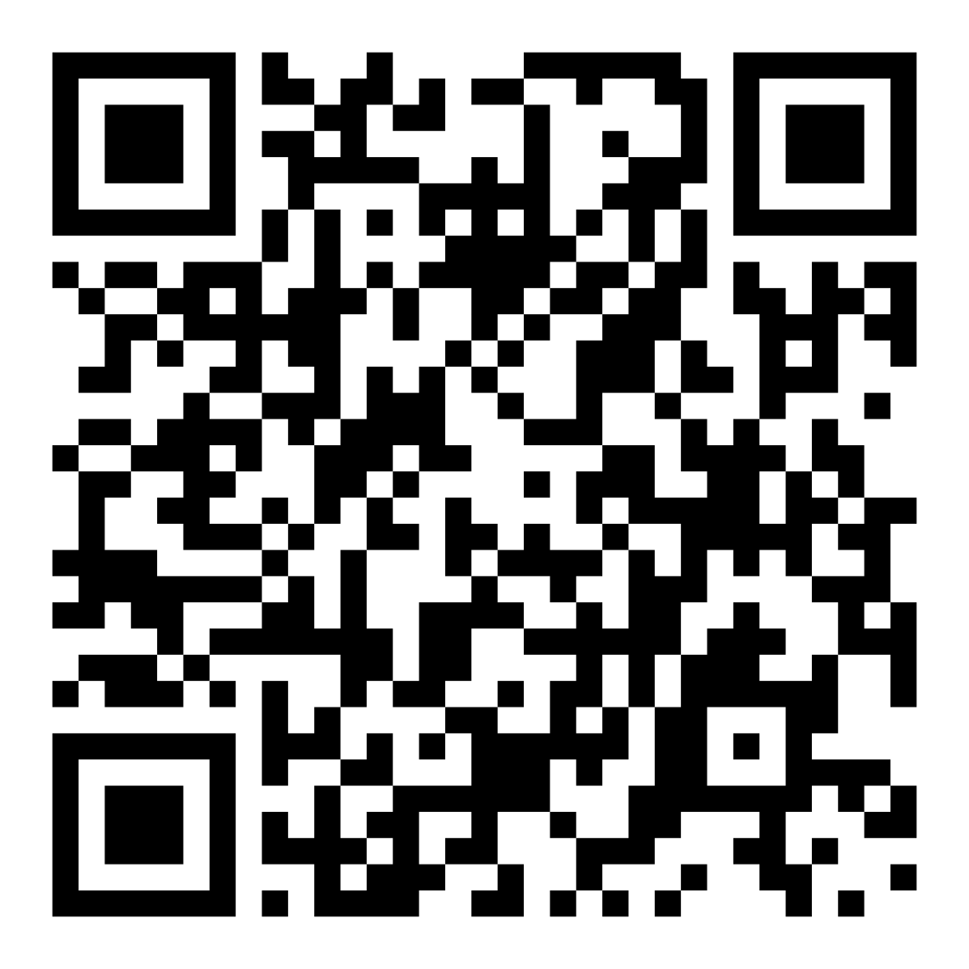
THANK YOU
You can download this presentation
and access additional information at
findusunderground.com/accessibility
Washington Public Ports Association • May 19, 2026

